Slide 1
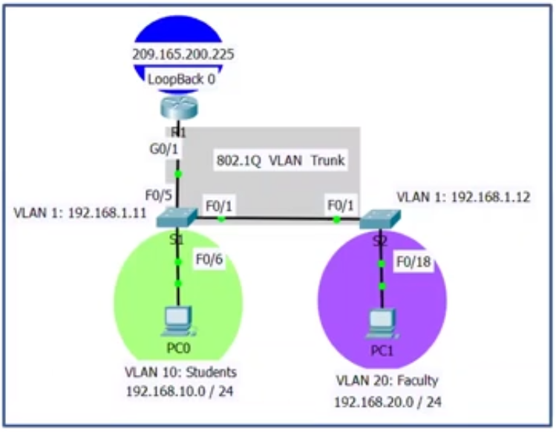
Laboratorio 2: Ruteo entre VLANs
VLAN 1: Native
192.168.1.0 /24
192.168.1.1
VLAN 10: Students
192.168.10.0 /24
VLAN 20: Faculty
192.168.20.0 /24

